Slide 1
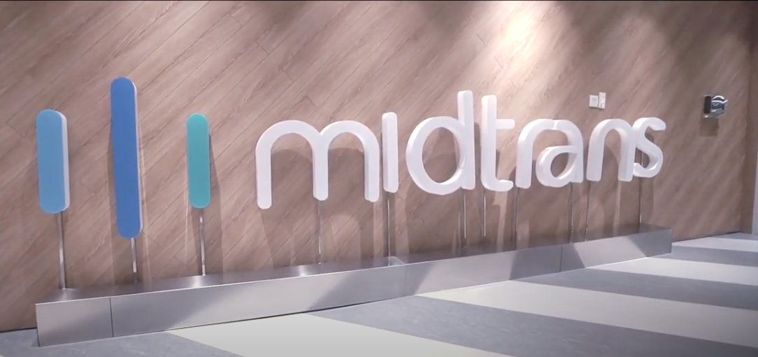
REPORT DEMO MID TRANS
Create by M.Zein Azhari

Slide 2
Test Case Report
Test Case Id | Tase Case | Actual Result | Expected Result | Steps | Status
TC01 | Make sure the buy now button is clickable | The buy now button can be accessed if clicked |  | 1. Open Browser 2. Navigate to url "https://demo.midtrans.com/" 3. Click button buy now | Pass
TC02 | Make sure the wallpaper replacement arrow can work to change the wallpaper | Button arrows can be used to change the screen wallpaper |  | 1. Open Browser 2. Navigate to url "https://demo.midtrans.com/" 3. Click button slide wallpaper | Pass
TC03 | Make sure the cancel button is clickable | If you click the cancel button it will return to the previous page |  | 1. Open Browser 2. Navigate to url "https://demo.midtrans.com/" 3. Click button buy now 4. Click button cancel | Pass
TC04 | Make sure the checkout button is clickable | If you click the checkout button it will continue to the next page |  | 1. Open Browser 2. Navigate to url "https://demo.midtrans.com/" 3. Click button buy now 4. Click button checkout | Pass
TC05 | Make sure if you don't fill in the entire input on the shopping cart then you can't proceed with the payment | Will be redirected to the start page and given a transaction failure notification |  | 1. Open Browser 2. Navigate to url "https://demo.midtrans.com/" 3. Click button buy now 4. Input all data with empty data 5. Click button Check out | Pass

Slide 3
Test Case Id | Tase Case | Actual Result | Expected Result | Steps | Status
TC06 | Fill in all the data on the shopping cart | The data will be processed to the next page |  | 1. Open Browser 2. Navigate to url "https://demo.midtrans.com/" 3. Click button buy now 4. Input all data 5. Click button checkout | Pass
TC07 | Enter the price with the appropriate data and verify with the data that appears in the order summary | The price data that will appear in the order summary will be the same as the price listed on the start page and shopping cart |  | 1. Open Browser 2. Navigate to url "https://demo.midtrans.com/" 3. Click button buy now 4. Input amount 5. Input all data 6. Click button checkout | Pass
TC08 | Entering biodata in the shopping cart will be the same as shipping details | The display entered in the shipping details corresponds to what was entered on the shopping card |  | 1. Open Browser 2. Navigate to url "https://demo.midtrans.com/" 3. Click button buy now 4. Input all data 5. Click button checkout 6. Click button Shipping details 7. Match data with shopping cart data | Pass
TC09 | Make sure the list content button using a credit card is clickable | If you click the list conten a credit card it will continue to the next page |  | 1. Open Browser 2. Navigate to url "https://demo.midtrans.com/" 3. Click button buy now 4. Input all data 5. Click button checkout 6. Click button continue 7. Click button credit/debit card | Pass
TC10 | Make sure the button on the cvv is clickable | If you press the cvv button you will get a notification of using cvv |  | 1. Open Browser 2. Navigate to url "https://demo.midtrans.com/" 3. Click button buy now 4. Input all data 5. Click button checkout 6. Click button continue 7. Click button credit/debit card 8. Click button ikon mark ccv | Pass

Slide 4
Test Case Id | Tase Case | Actual Result | Expected Result | Steps | Status
TC11 | Process the payment with 10% off and verify the total price | Ensure that the payment process can run and ensure the total amount that appears is appropriate after being given a 10% discount and getting a ticket |  | 1. Open Browser 2. Navigate to url "https://demo.midtrans.com/" 3. Click button buy now 4. Input all data 5. Click button checkout 6. Click button continue 7. Click button credit/debit card 8. Input card number, expire date and cvv 9. Click button ceklis in potongan 10% 10. Click button pay now 11. Input password 12. Click button ok | Pass
TC12 | Process payment with a discount of Rp.10 and verify the total price | Ensure that the payment process can run and ensure the total amount that appears is appropriate after being given a Rp.10 discount and getting a ticket |  | 1. Open Browser 2. Navigate to url "https://demo.midtrans.com/" 3. Click button buy now 4. Input all data 5. Click button checkout 6. Click button continue 7. Click button credit/debit card 8. Input card number, expire date and cvv 9. Click button ceklis in potongan 10 rupiah 10. Click button pay now 11. Input password 12. Click button ok | Pass
TC13 | Make sure the payment process with a Rp 2000 discount will not continue because this discount is not available | Ensure that the payment process can run and ensure the total amount that appears is appropriate after being given a Rp.2.000 discount and getting a ticket |  | 1. Open Browser 2. Navigate to url "https://demo.midtrans.com/" 3. Click button buy now 4. Input all data 5. Click button checkout 6. Click button continue 7. Click button credit/debit card 8. Input card number, expire date and cvv 9. Click button ceklis in promo midtrans 10. Click button pay now | Pass

Slide 5
Test Case Id | Tase Case | Actual Result | Expected Result | Steps | Status
TC14 | Did not enter password on final payment verification | If you don't enter a Password and click the ok button it will immediately show the transaction failed | If you don't enter a Password and click the ok button, it will give a notification that you haven't filled in the Password yet | 1. Open Browser 2. Navigate to url "https://demo.midtrans.com/" 3. Click button buy now 4. Input all data 5. Click button checkout 6. Click button continue 7. Click button credit/debit card 8. Input card number, expire date and cvv 9. Click button ceklis in promo midtrans 10. Click button pay now 11. Click button ok | Failed
TC15 | Make sure the use another payment options button is clickable | After clicking the use another payment option button, it will be linked to the payment options |  | 1. Open Browser 2. Navigate to url "https://demo.midtrans.com/" 3. Click button buy now 4. Input all data 5. Click button checkout 6. Click button continue 7. Click button credit/debit card 8. Input card number, expire date and cvv 9. Click button ceklis in promo midtrans 10. Click button pay now 11. Click button ok 12. Click button use another payment | pass
TC16 | Not inputting phone number in shopping cart | Phone number data input will be inputted when the credit/debit card page |  | 1. Open Browser 2. Navigate to url "https://demo.midtrans.com/" 3. Click button buy now 4. Input all data except phone number 5. Click button checkout 6. Click button continue 7. Click button credit/debit card | Pass

Slide 6
Test Case Id | Tase Case | Actual Result | Expected Result | Steps | Status
TC17 | Did not enter email in shopping cart | Will be redirected to the start page and given a transaction failure notification |  | 1. Open Browser 2. Navigate to url "https://demo.midtrans.com/" 3. Click button buy now 4. Input all data except phone number 5. Click button checkout | Pass
TC18 | Verify the entire button back and ensure it will return to the previous frame | When clicking the back button will return to the previous page |  | 1. Open Browser 2. Navigate to url "https://demo.midtrans.com/" 3. Click button buy now 4. Input all data except phone number 5. Click button checkout 6. Click button continue 7. Click button credit/debit card 8. Click button back 9. Click button back | Pass
TC19 | Enter input 3 times repeatedly on input credit card number, expire date and vvp | The payment process will be successful after repeating the credit card input, expire date and vvp |  | 1. Open Browser 2. Navigate to url "https://demo.midtrans.com/" 3. Click button buy now 4. Input all data except phone number 5. Click button checkout 6. Click button continue 7. Click button credit/debit card 8. Input card number, expire date and cvv(3rd input is correct) 9. Click button back now | Pass

Slide 7
Test Case Id | Tase Case | Actual Result | Expected Result | Steps | Status
TC21 | After closing the browser and opening the start page again, the system will fail to checkout | When you close the browser and return to the start page, you cannot make the payment process | It should be when you return after closing the browser, the payment process can be continued | 1. Open Browser 2. Navigate to url "https://demo.midtrans.com/" 3. Click button buy now 4. Input all data except phone number 5. Click button checkout 6. Click button continue 7. Click button credit/debit card 8. Input card number, expire date and cvv 9. Click button pay now | Blocked
TC22 | Enter email on credit/debit card page with wrong character input | An error message payment data is invalid will appear |  | 1. Open Browser 2. Navigate to url "https://demo.midtrans.com/" 3. Click button buy now 4. Input all data except phone number 5. Click button checkout 6. Click button continue 7. Click button credit/debit card 8. Fill in the email input with wrong data 9. Click button pay now | Pass
TC23 | Enter the card number, expiration date and CVV with the problematic credit card | When entering the wrong card number, at the end of the payment process, a failed payment ticket will appear |  | 1. Open Browser 2. Navigate to url "https://demo.midtrans.com/" 3. Click button buy now 4. Input all data except phone number 5. Click button checkout 6. Click button continue 7. Click button credit/debit card 8. Input card number, expire date and cvv 9. Click button back pay now 10. Input password 12. Click button ok | Pass

Slide 8
Test Case Id | Tase Case | Actual Result | Expected Result | Steps | Status
TC24 | Clicking the X button on the order summary | The X button on the order summary is directly linked to the main page | There should be a button on this page that functions to return to the previous page not to the main page | 1. Open Browser 2. Navigate to url "https://demo.midtrans.com/" 3. Click button buy now 4. Click button checkout 5. Click button X | Failed
TC25 | Verify the address display in the order summary | No separator character in address, city and postal code | The address display in shipping details requires a period or comma to distinguish between address, city and postal code | 1. Open Browser 2. Navigate to url "https://demo.midtrans.com/" 3. Click button buy now 4. Click button checkout 5. Click button shipping details | Failed
TC26 | Entering the name character input on the shopping cart exceeds 50 letters | In the name input, you can fill in the input until it is unlimited | There should be a character input limit on the 50 letter name input | 1. Open Browser 2. Navigate to url "https://demo.midtrans.com/" 3. Click button buy now | Failed
TC27 | Entering the email character input on the shopping cart exceeds 30 letters | In email input, you can fill in unlimited inputs | There should be a character input limit on email input of 30 characters | 1. Open Browser 2. Navigate to url "https://demo.midtrans.com/" 3. Click button buy now | Failed
TC28 | Enter the character phone number input on the shopping cart exceeds 16 digits | At the phone number input, you can fill in unlimited inputs | There should be a limit for inputting characters in the phone number input of 16 digits | 1. Open Browser 2. Navigate to url "https://demo.midtrans.com/" 3. Click button buy now | Failed
TC29 | Entering character input on the city on the shopping cart exceeds 85 characters | At the input city, you can fill in the input until it is unlimited | There should be a character input limit on city input of 85 characters | 1. Open Browser 2. Navigate to url "https://demo.midtrans.com/" 3. Click button buy now | Failed

Slide 9
Test Case Id | Tase Case | Actual Result | Expected Result | Steps | Status
TC30 | Entering the postal code character input on the shopping cart as much as 5 digits and can only fill in with numeric input | In postal code input, you can fill in unlimited inputs | There should be a character input limit on postal code input of 5 digits | 1. Open Browser 2. Navigate to url "https://demo.midtrans.com/" 3. Click button buy now | Failed
TC31 | Entering data on shopping carts with characters that do not match each input | If one of the inputs in the shopping cart is filled in more than the number of characters in each input or filled in with the wrong input, it will return to the main page | It should show the wrong input at the wrong input place so as not to make it difficult for users to find out the wrong input | 1. Open Browser 2. Navigate to url "https://demo.midtrans.com/" 3. Click button buy now 4. Click button checkout | Failed
TC32 | Checking suggest on input card number | Suggest card number will follow if the user scrolls | When the page is scrolled, suggest input card number should not follow | 1. Open Browser 2. Navigate to url "https://demo.midtrans.com/" 3. Click button buy now 4. Input all data except phone number 5. Click button checkout 6. Click button continue 7. Click button credit/debit card 8. Click inputan card number 9. Scroll page | Failed

Slide 10
Test Case Id | Tase Case | Actual Result | Expected Result | Steps | Status
TC33 | Check the email input field on the credit/debit card page | There will be an email input on the credit/debit card page even though you have already entered the email on the shipping details | Because you have entered an email on the shipping cart page and if you don't fill in the email input on the shipping cart the payment process can't be continued, then there is no need for input on the debit/credit card page and if it is needed it is necessary to add an edit email feature | 1. Open Browser 2. Navigate to url "https://demo.midtrans.com/" 3. Click button buy now 4. Input all data except phone number 5. Click button checkout 6. Click button continue 7. Click button credit/debit card 8. Input card number, expire date and cvv 9. Click button back pay now 10. Input password 12. Click button ok | Failed
TC34 | Verify button close on failed notification and successful payment notification | When you click the close button, the notification will be closed |  | 1. Open Browser 2. Navigate to url "https://demo.midtrans.com/" 3. Make the payment process successful 4. Click the close button on the notification 5. perform data input with wrong data 6. Click the close button on the notification | Pass
TC35 | The data on the shopping cart has been directly inputted in the data input field | All inputs have been automatically filled | The initial data entry should be in an unfilled state, and even though you want to give an example for the input, you can create shadow text on each input | 1. Open Browser 2. Navigate to url "https://demo.midtrans.com/" 3. Click button buy now | Failed

Slide 11
Test Case Execution
22 passed
22 of 35 Passed
1 Blocked
0 of 35 Passed
0 Retest
0 of 35 Passed
12 Failed
0 of 35 Passed
63%
Passed
22/35 of the whole test case

Slide 12
Execution Environment & Summary Katalon
Host Name
TELKOM - 10.48.104.107
Total Test Case
34
OS
Windows 10 32bit
Test Case Passed
34
Katalon Version
7.8.2.208
Error
0
Elapsed
11m - 25,716s
Browser
Chrome 97.0.4692.99

Slide 13
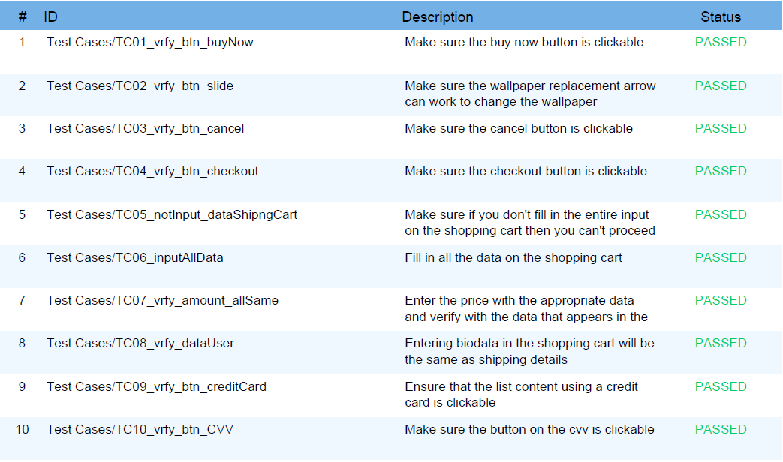
Result Test Case In Katalon

Slide 14
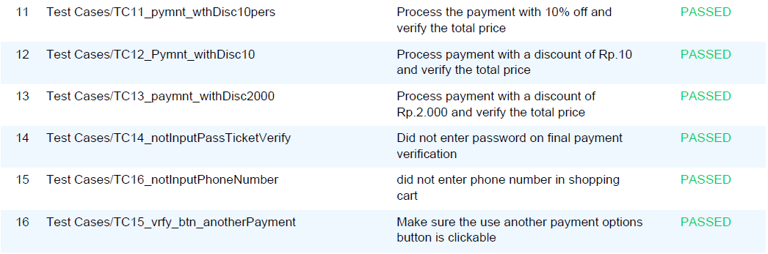
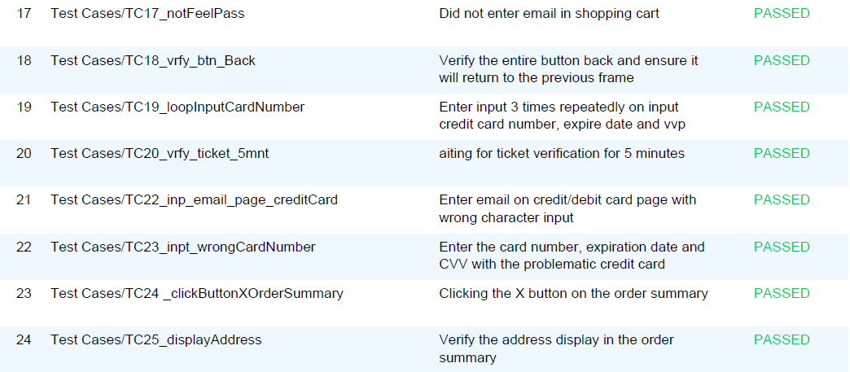

Slide 15
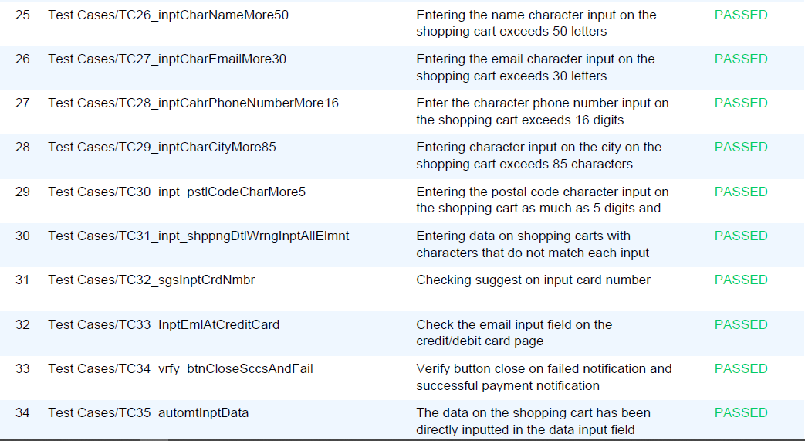

Slide 16
Average Time Per Case
Second
Total Elapsed 11m - 25,716s

